Slide 1
What is a health economist, what do they do, can they be trusted and are they the power behind the throne of drug/device development?
Clive Pritchard, ICON Clinical Research

Slide 2
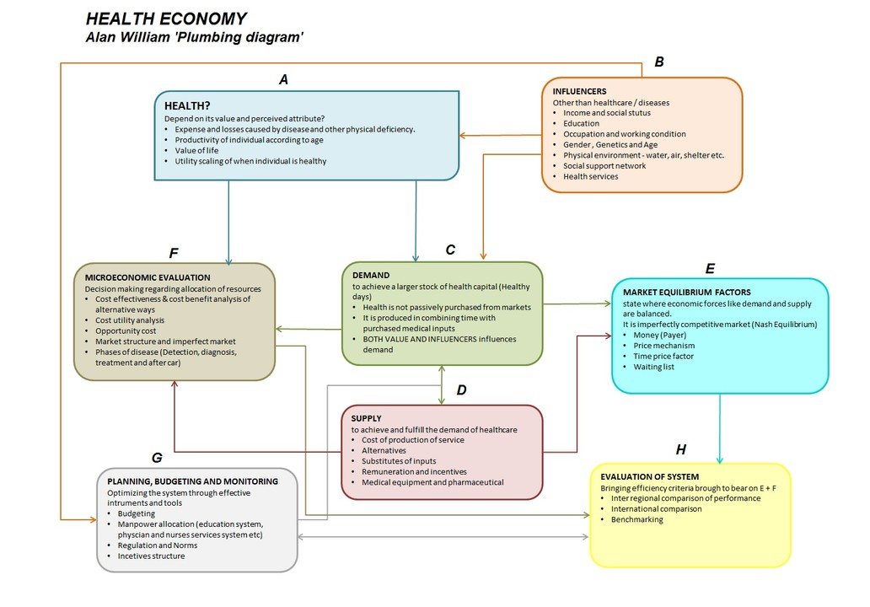
What do health economists do?
Source: Williams A (1987). Health economics: the cheerful face of a dismal science. In A Williams (ed.) Health and Economics. London: Macmillan

Slide 3
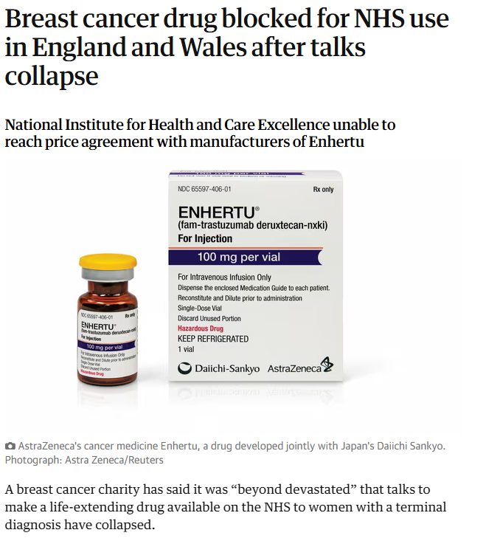
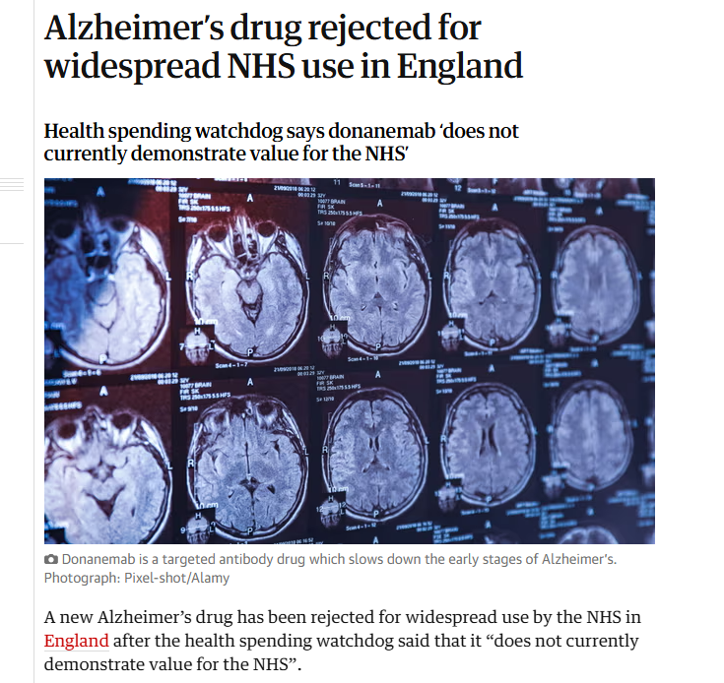
Source: https://www.theguardian.com/society/2024/nov/19/breast-cancer-drug-blocked-nhs-use-england-and-wales
https://www.theguardian.com/society/2024/oct/23/alzheimers-drug-donanemab-rejected-widespread-nhs-use-england

Slide 4
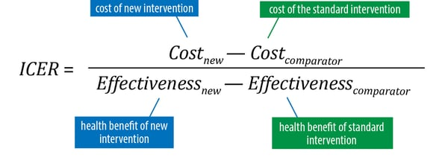
How are these decisions made?
The incremental cost-effectiveness ratio (ICER)
Costs and effectiveness are often considered over the patient’s lifetime
Effectiveness is typically measured in terms of quality adjusted life years (QALYs) – cost utility analysis
Decision makers are concerned with the value of a new technology in clinical practice

Slide 5
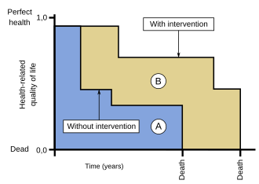
QALYs

Slide 6
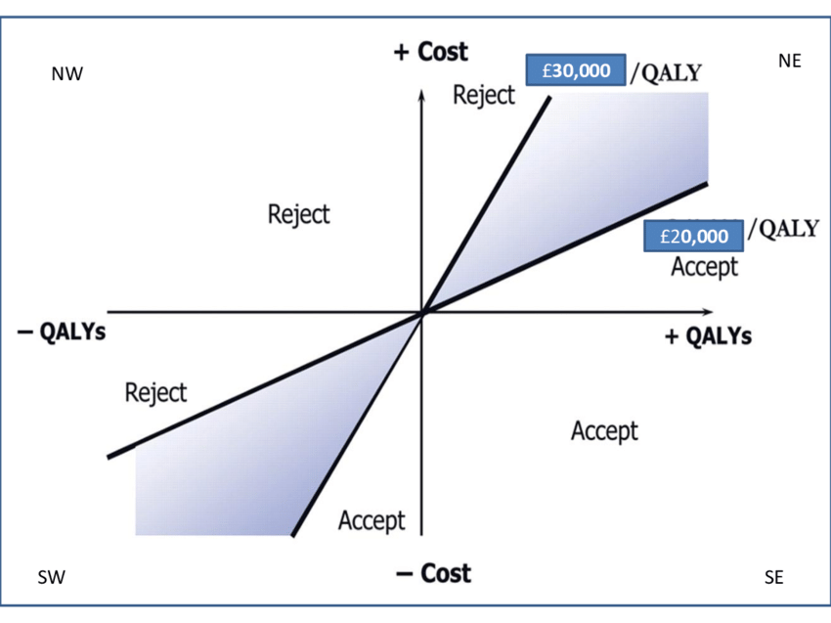
Cost per QALY ratio

Slide 7

Trust pt1: Assumptions 1 - 3
QALYs are an appropriate measure of health benefit
  A concept developed and championed by economists
Maximisation of QALYs is an appropriate goal
Our ICER reflects opportunity cost at the margin
  What is displaced to accommodate a new therapy?
  How many QALYs would displaced therapies provide?
  Is £20,000 per QALY too high?

Slide 8
Trust pt 2: How are these results generated?
Clinical trials? Important source of treatment effect but:
  Short period of follow-up
  Don’t necessarily include all relevant comparators
  May be unrepresentative of clinical practice
Economic (decision analytic) models drawing on:
  Epidemiology
  Clinical trials
  Real world evidence
  Statistical modelling
  Expert opinion/assumptions when data is absent
Decision analytic models are not ‘science’ (in the sense of testing a falsifiable hypothesis)
  Health economists tend not to pay too much attention to statistical significance

Slide 9
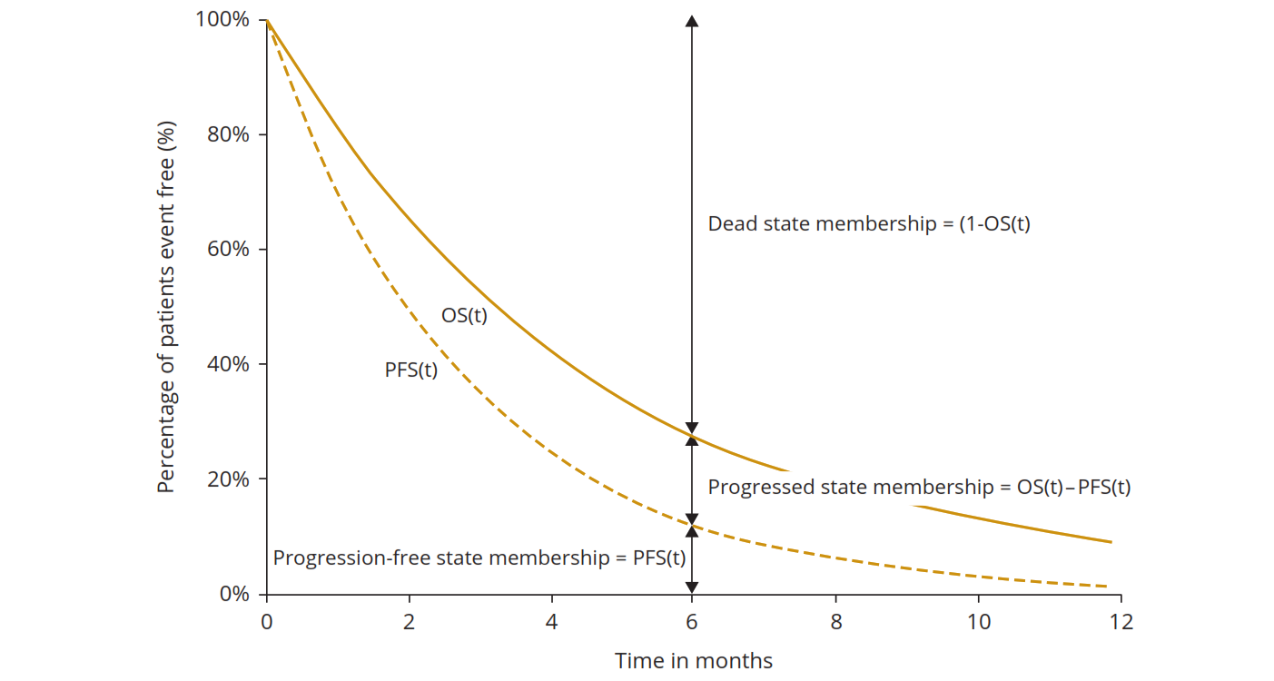
Oncology example – partitioned survival model (PSM)
Source: Woods B S, Sideris E, Palmer S et al. (2020). Partitioned survival and state transition models for healthcare decision making in oncology: where are we now? Value in Health 23(12):1613-1621.

Slide 10
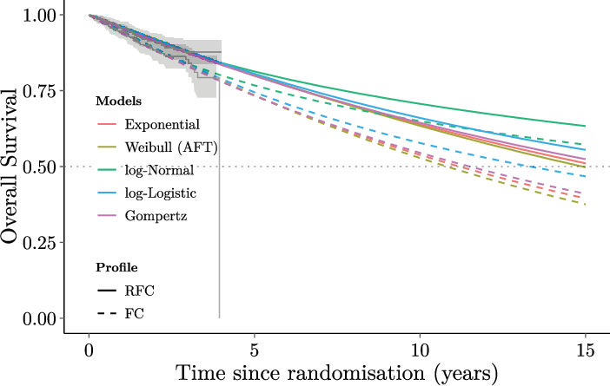
Survival extrapolation
Source: Che Z, Green N, Baio G (2002). Blended survival curves: a new approach to extrapolation for time-to-event outcomes from clinical trials in health technology assessment. Medical Decision Making 43(3): 299-310.

Slide 11
Are health economists the power behind the throne of drug/device development?
Over the last 25 years, there has been wide acceptance of:
  The role of cost-effectiveness analysis in rationing health care resources
  The role of QALYs as a universal measure of health benefit
  The formal institutional use of cost-effectiveness analysis in making decisions about the reimbursement/pricing and use of new drugs
Economics has influenced R&D
  EQ-5D is incorporated as standard into many clinical trials
  Industry uses early economic modelling to inform go/no go decisions
Caveat: a Eurocentric rather than US-centric perspective

Slide 12
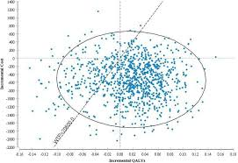
Conclusions – enhancing trust?
Models can be seen as a ‘black box’ – results are not always easy to explain
We can do more to instil confidence in modelling
  Designing models with clinical input
  Appropriately exploring uncertainties
  External validation of models
  Do the results have face validity?
  Better communication of the results of models
Greater transparency would help to provide reassurance but hampered by the desire to set confidential discounts

Slide 13

Thank you for listening

