Slide 1


Let’s talk rates:
What are MedComms freelancers charging in 2025?
Steph Carter and Vicki Evans
MedComms Networking Event Pre-Christmas Event 2025
Manchester, December 2025

Slide 2
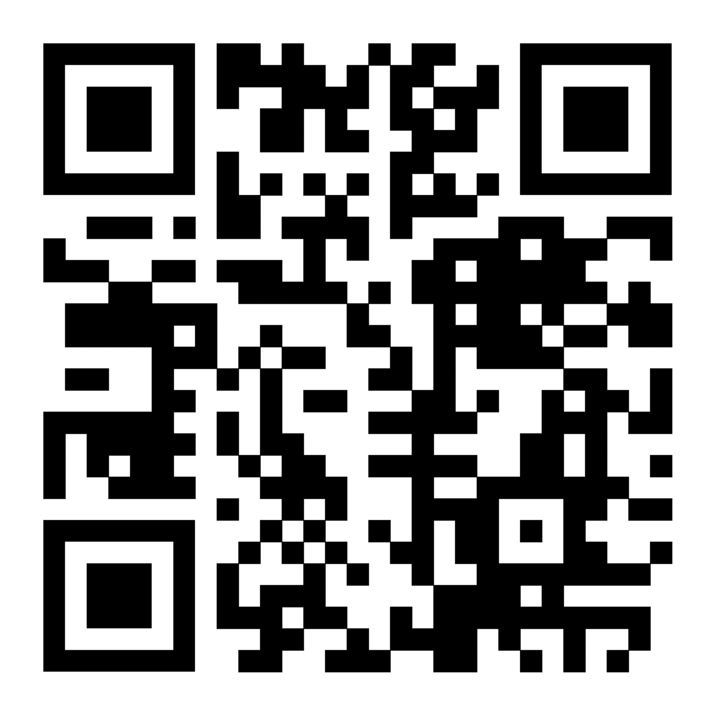

Insights from the Freelance Medical Writer and Editor Survey 2025
Who conducted the survey?
One of the largest freelance medical writer groups in the UK and Ireland (founded November 2022; 139 members)
Active LinkedIn group with supportive WhatsApp group
Free to join for established freelance medical writers and editors
Join here: https://www.linkedin.com/groups/12729342/
© 2025 Freelance Medical Writers Based in UK & Ireland

Slide 3
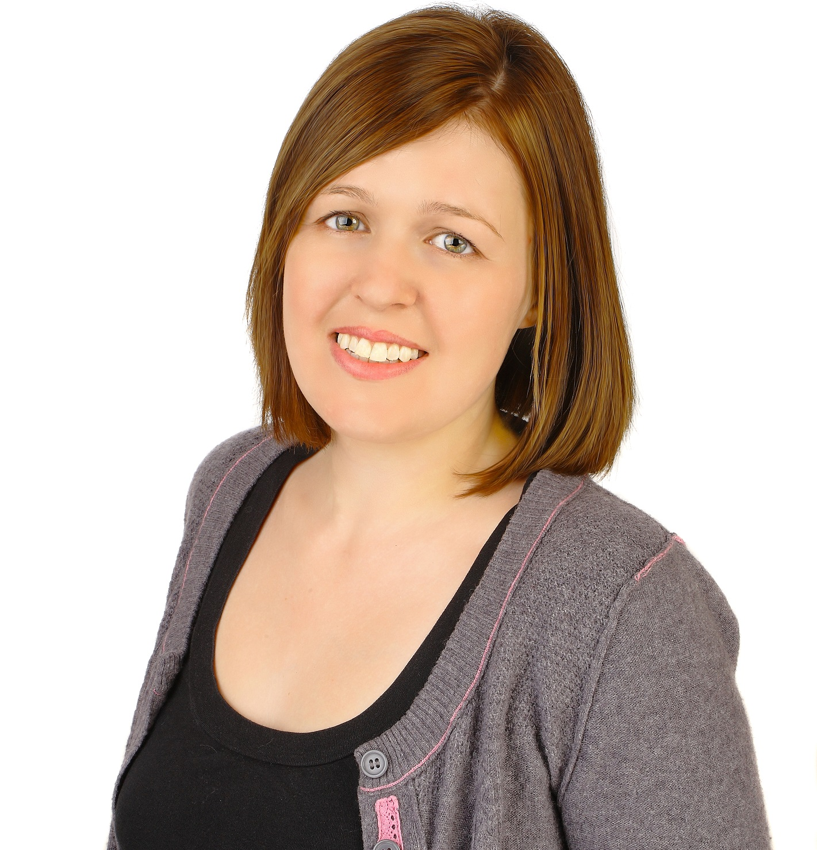
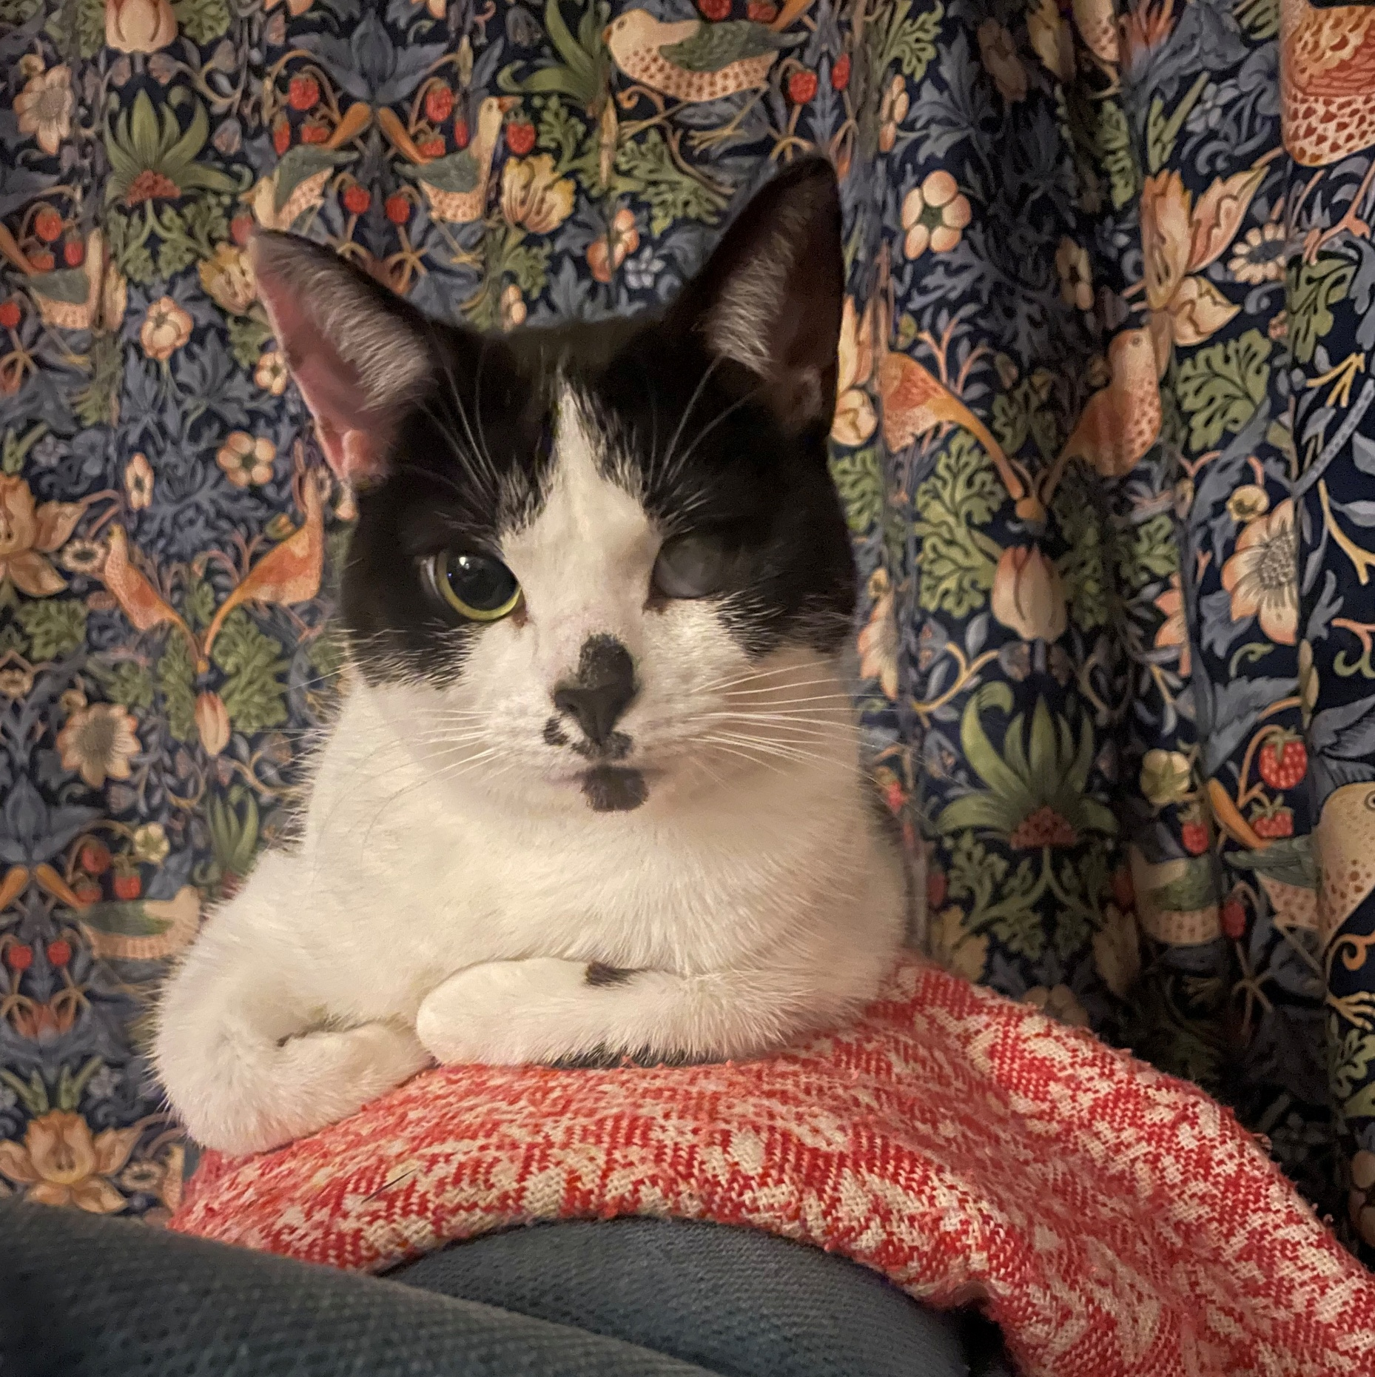

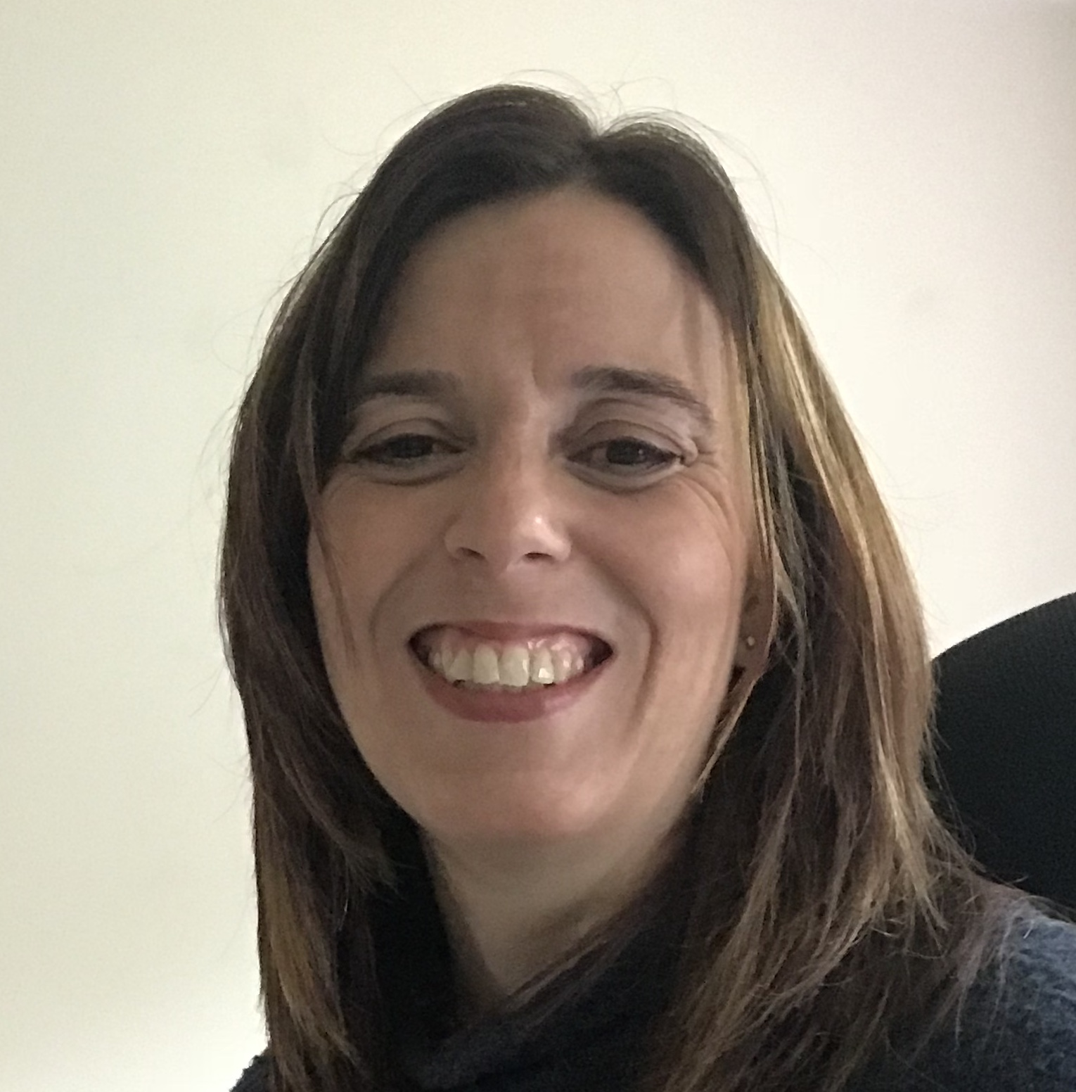
Who are we?
Steph
Medical writer for almost 14 years and freelancer for 5 years
Based in Manchester
Mainly work on publications (plus some medical affairs)
Current
foster cat
Vicki
Freelancing for 16 years as an Account Director and Medical Writer
Based in North Yorkshire
Love meetings and scientific content
Admin for the UK & Ireland Medical Writers group
Lazy co-workers

Slide 4
Insights from the Freelance Medical Writer and Editor Survey 2025
Rationale
Multiple surveys (e.g., by EMWA, recruitment agencies etc) report freelancer rates, but the landscape is rapidly changing
With increasing numbers of new and often inexperienced freelancers entering the market, it is uncertain whether rates are being maintained by established freelancers
Existing surveys often categorise freelancers by job title such as MW, SMW, PMW, SD etc – terms that many freelancers and clients don’t use
We conducted an independent survey to capture current freelance medical writing and editing rates, with a focus on established freelancers in the UK and Ireland
EMWA, European Medical Writers Association; MW, medical writer; PMW, principle medical writer; SD, scientific director; SMW, senior medical writer
© 2025 Freelance Medical Writers Based in UK & Ireland

Slide 5




Insights from the Freelance Medical Writer and Editor Survey 2025
Methods
Survey
Distribution
Analysis
Exclusions
Anonymous, run
via Google Forms (1–31 August 2025)
Shared on LinkedIn, in the MedComms Workbook, and among regional freelance WhatsApp groups in the UK
Median hourly rates (in GBP) calculated by client type, location and years of experience
Rates in other units (e.g. per word), obvious typos (e.g., £690 per hour)
GBP, Great British Pounds
© 2025 Freelance Medical Writers Based in UK & Ireland

Slide 6





Insights from the Freelance Medical Writer and Editor Survey 2025
Respondents (N=150)
85% were based in the UK or Ireland
93% were medical writers,ª 7% were editors
65% had >10 years experience^{b}, 25% had >20 years experience^{b}
74% worked outside IR35 (UK only)
79% were client-facing when working with MedComms agencies (28% regularly, 51% occasionally)
ªIncludes respondents who described themselves as both writers and editors.
^{b}Total years of experience in-house and as a freelancer.
© 2025 Freelance Medical Writers Based in UK & Ireland

Slide 7
Insights from the Freelance Medical Writer and Editor Survey 2025
UK/I Medical Writers (N=117): Breadth of experience
Types of projects
Numbers of project types
CME, continuing medical education; HEOR, Health Economics and Outcomes Research; UK/I, UK and Ireland.
© 2025 Freelance Medical Writers Based in UK & Ireland

Slide 8
Insights from the Freelance Medical Writer and Editor Survey 2025
UK/I writers: Median hourly rate (GBP) by experienceª
£75
£75
£75
£66
£57
 | All (N=117) | <5 years (n=4) | 5–10 years (n=28) | 10–20 years (n=52) | >20 years (n=33)
Median | £75 | £57 | £66 | £75 | £75
Mean | £75 | £57 | £69 | £78 | £79
IQR | £65–80 | £47–66 | £65–75 | £70–80 | £70–85
Range | £38–130 | £38–75 | £50–85 | £55–120 | £60–130
ªTotal years of experience in-house and as a freelancer.
IQR, interquartile range; UK/I, UK and Ireland.
© 2025 Freelance Medical Writers Based in UK & Ireland

Slide 9
Insights from the Freelance Medical Writer and Editor Survey 2025
UK/I writers: Median hourly rate (GBP) by client type
£80
£75
£71
£72
£70
£65
 | All clients (N=117) | Freelance platforms (n=36) | Recruiters (n=47) | CROs (n=26) | MedComms agencies (n=105) | Pharmaª (n=55)
Median | £75 | £65 | £70 | £71 | £72 | £80
Mean | £75 | £70 | £75 | £76 | £72 | £91
IQR | £66–80 | £65–71 | £65–80 | £65–82 | £67–79 | £70–103
Range | £38–130 | £30–130 | £30–160 | £40–130 | £30–115 | £40–160
ªMany pharma contractors work on a per project basis, making hourly-rate calculations challenging
CROs, contract research organisations; IQR, interquartile range; UK/I, UK and Ireland.
© 2025 Freelance Medical Writers Based in UK & Ireland

Slide 10
Insights from the Freelance Medical Writer and Editor Survey 2025
UK/I writers: Median hourly rate (GBP) by IR35 status
£75
£75
£75
£70
£70
 | All (N=117) | Outside IR35 only (n=86) | Inside IR35 only (n=3) | Both in and out IR35 (n=13) | NAª (n=14)
Median | £75 | £75 | £70 | £70 | £75
Mean | £75 | £76 | £69 | £73 | £76
IQR | £66–80 | £70–80 | £68–71 | £65–80 | £65–79
Range | £38–130 | £38–130 | £65–72 | £55–95 | £60–115
ªMostly freelancers who operate as sole traders.
© 2025 Freelance Medical Writers Based in UK & Ireland

Slide 11
Insights from the Freelance Medical Writer and Editor Survey 2025
Writers: Median hourly rate (GBP) by location
£87
£75
£69
£17
 | UK/I (N=117) | North America (n=4) | Europe excl. UK/I (n=11) | India/ Bangladesh (n=4) | Australia (n=1) | Malaysia (n=1) | Nigeria (n=1)
Median | £75 | £87 | £69 | £17 | £65 | £53 | £80
Mean | £75 | £99 | £61 | £16 | – | – | –
IQR | £65–80 | £77–110 | £48–71 | £8–25 | – | – | –
Range | £38–130 | £75–147 | £20–80 | £7–25 | – | – | –
IQR, interquartile range; UK/I, UK and Ireland.
© 2025 Freelance Medical Writers Based in UK & Ireland

Slide 12
Insights from the Freelance Medical Writer and Editor Survey 2025
UK/I editors: Median hourly rate (GBP) by client type
£53
£50
£50
£50
£50
£48
 | All clients (N=10) | Freelance platforms (n=5) | Recruiters (n=4) | MedComms agencies (n=10) | Pharma (n=3) | CROs (n=2)
Median | £50 | £48 | £50 | £50 | £50 | £53
Mean | £48 | £48 | £51 | £50 | £50 | £53
IQR | £46–54 | £45–50 | £49–51 | £48–54 | £48–53 | £51–54
Range | £20–60 | £40–55 | £48–55 | £40–60 | £45–55 | £50–55
CRO, contract research organisation; IQR, interquartile range; UK/I, UK and Ireland.
© 2025 Freelance Medical Writers Based in UK & Ireland

Slide 13
Insights from the Freelance Medical Writer and Editor Survey 2025
All respondents: Changes in rates since 2024
Not answered (<1%)
Decreased (3%)
Increased
(45%)
No change
(51%)
© 2025 Freelance Medical Writers Based in UK & Ireland

Slide 14
Insights from the Freelance Medical Writer and Editor Survey 2025
All respondents: Comments
I work with several large med comms agencies and none have had an issue with £80/hour for up to 4 days/week with minimum client contact
Agencies are tending to ask for lower rates for long-term projects, but I have not accepted these. Recruiters have not pushed for lower rates, although if client says they pay a lower rate, I’m not interested
I would expect a rate of at least £85 if I’m regularly client-facing in a role for a med comms agency
I charge higher rates to clients in the USA
I stick at what I want and don’t work via platforms or recruiters who are taking their slice
Work has been slow to pick up in 2024. I notice this changing now.
I haven’t increased my rates for 3 years. My working hours have had to increase to cope with the rising cost of living. In the last year I’ve had to work 50-60 hours/week, as I’m the main bread winner.
I'm finding a lot of push-back on rates
Considering increasing universally to £80 as work seems more stable and in demand again this year.
Agencies and recruiters are not paying enough - so I often say no
Accepted a lower rate in 2025 compared to 2024 as I had no other client
There’s a lot of competition, and lots of writers with relatively few years of experience, which has meant rates have not increased with inflation
© 2025 Freelance Medical Writers Based in UK & Ireland

Slide 15
Insights from the Freelance Medical Writer and Editor Survey 2025
Conclusions
In a cohort of highly experienced freelancers in the UK and Ireland, median hourly rates were £75 for medical writers and £50 for editors
Direct contracts with pharma clients yielded the highest rates for writers
Experience strongly influenced earnings, with higher rates linked to longer time in the industry
In the past 12 months, most writers had either increased their rates (45%) or kept them unchanged (51%)
© 2025 Freelance Medical Writers Based in UK & Ireland

Slide 16
Insights from the Freelance Medical Writer and Editor Survey 2025
Limitations
Respondents were predominantly based in the UK or Ireland and highly experienced, limiting subgroup analyses
Few editors completed the survey
Many pharma contractors work on a per project basis, making hourly-rate calculations challenging
Hourly rates alone may not reflect total project costs, as more experienced writers and editors may complete projects faster and their work require fewer revisions
© 2025 Freelance Medical Writers Based in UK & Ireland

Slide 17

Thanks to all the freelancers who responded to the survey and all the members of the group who helped with the design and analysis of the results
Merry Christmas!
Freelance Medical Writers based in UK and Ireland

Slide 18
Insights from the Freelance Medical Writer and Editor Survey 2025
UK/I writers: Median hourly rate (GBP) by specialty
£86
£75
£75
£75
£75
£75
£75
£73
£70
£66
 | Med affairs materials (n=83) | Publications (n=80) | Promo materials (n=56) | Patient materials (n=44) | Events (n=41) | Strategic (n=35) | CME (n=29) | HEOR (n=17) | Regulatory writing (n=13) | Health & Wellness blogs (n=4)
Median | £75 | £75 | £73 | £75 | £70 | £75 | £75 | £75 | £86 | £66
Mean | £73 | £74 | £73 | £75 | £72 | £77 | £75 | £75 | £88 | £73
IQR | £66–80 | £69–80 | £65–80 | £69–80 | £65–79 | £70–80 | £65–80 | £70–80 | £70–95 | £55–84
Range | £38–120 | £38–120 | £38–120 | £44–120 | £38–115 | £55–120 | £60–120 | £60–95 | £60–130 | £38–120
CME, continuing medical education; HEOR, Health Economics and Outcomes Research; IQR, interquartile range; UK/I, UK and Ireland.
© 2025 Freelance Medical Writers Based in UK & Ireland

