Slide 1
A Celebration of the Medical Communication Community
MedComms Day 2025
Trends in our industry - and how to respond?
Dawn Lobban

Slide 2






My medcomms journey… that has informed my perspective
7
Amica Scientific
5
Spirit (OpenHealth)
  Small agency
1
Gardiner Caldwell (Inizio)
  Eary established agency
6
Envision
  Large agency
2
Renovo
  Small Biotech
4
Back to Ashfield (Inizio)
3
Bioscript
  V small agency
What
helped?
Effective training
Talented colleagues
Supportive managers
Inspiring mentors
Tolerant family!

Slide 3
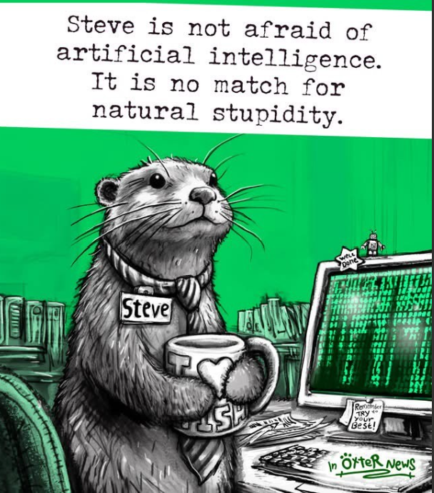
Trend:
The exponential growth of artificial intelligence in medical communications

Slide 4
A.I. presents a number of opportunities and challenges for our industry
Opportunities
New challenges
New ways of working
  Meeting minutes
  Literature summaries
  Content generation
  Publication drafts
  Plain language summaries of publications
  Medical information Chatbots
  Strategic planning and competitor intelligence
  Confidentiality
  Inaccuracies and hallucinations
  Trust and transparency
  Explainability
  Context and nuances
  Volume vs quality?
  AI use policies
  AI workflows
  AI training
  New stakeholders

Slide 5
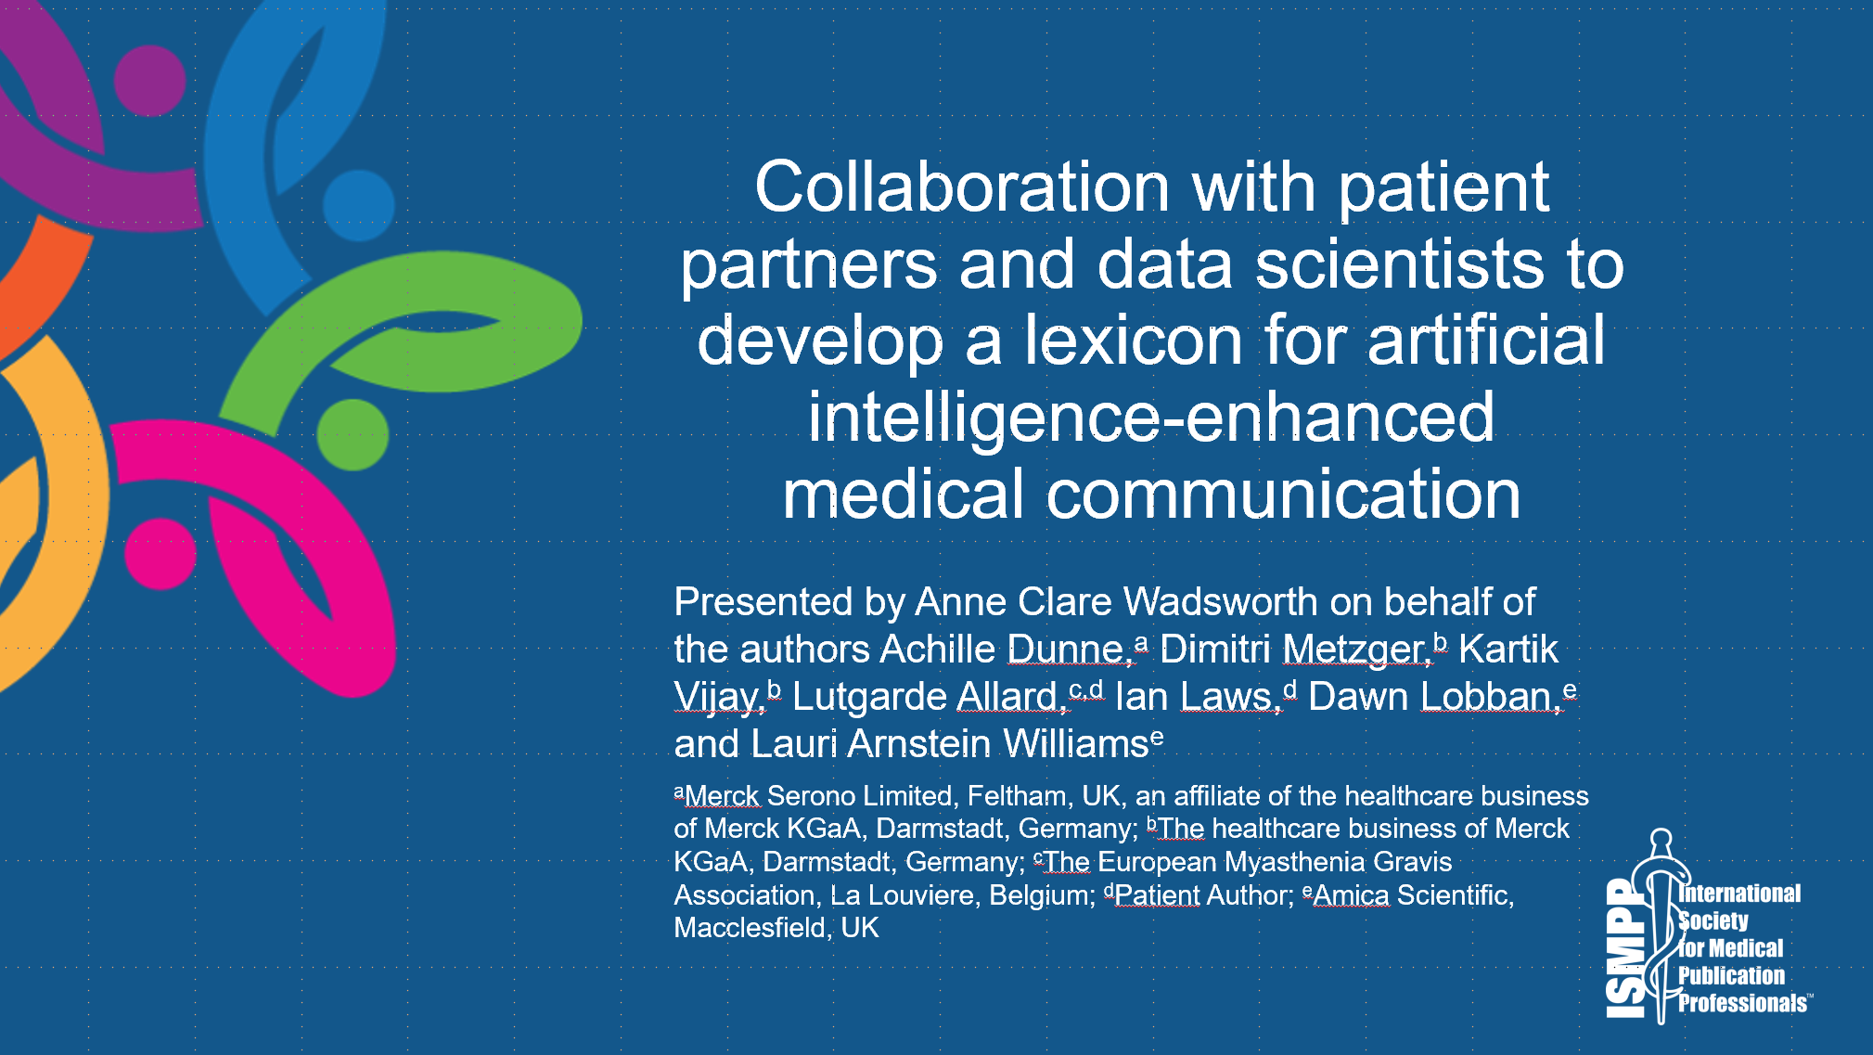
Through collaborations with new stakeholder groups, we can develop new A.I. enabled solutions
1
Development of an AI-applied patient lexicon in a rare disease
2
Co-created with patient partners and data scientists
3
To support clarity, consistency, and readability of plain language writing
AI assistants can support the integration of patient lexicons into workflows more seamlessly than traditional formats
4

Slide 6
The ‘Human-in-the-loop’ is critical – but who are they?
AI won't take your job.
Someone using AI will
Scott Gallway, NYU Professor
1
Implications for team structures?
2
Implications for career training and development?
3
Implications for the next generation?

Slide 7
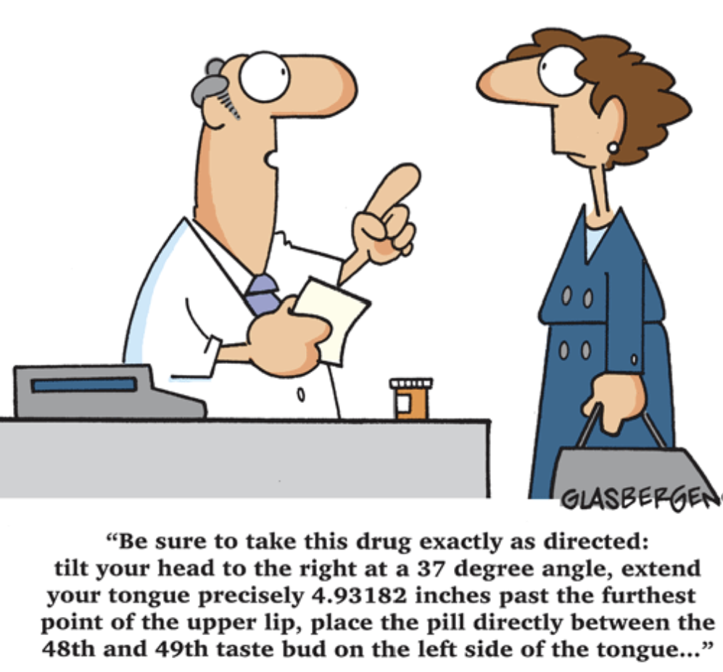
Trend: The rise of patient engagement in drug development

Slide 8
(Perceived) barriers to patient engagement in Medical Affairs have hindered progress
Major barrier for Patient Centricity
28%
Compliance (e.g. privacy, legal, or regulation concerns)
16%
Financial constraints
13%
Time constraints or too small team to prepare and execute appropriately
10%
Not enough awareness within organisation
9%
I did not face any barriers
8%
Other
6%
Not enough involvement by the medical function
5%
Patients and patient organisations not considered key stakeholders by the organisation
4%
Insufficient support from leadership
1%
Dissatisfying or insufficient feedback
N=93. Participants were asked to select their #1 major barrier from this list in a Medical Affairs Professional Society (MAPS) Patient Centricity survey conducted in November 2022.
Patient Centricity in Medical Affairs: Identifying and Overcoming Barriers. MAPS Patient Centricity Focus Area Working Group. Webinar, 2023.

Slide 9
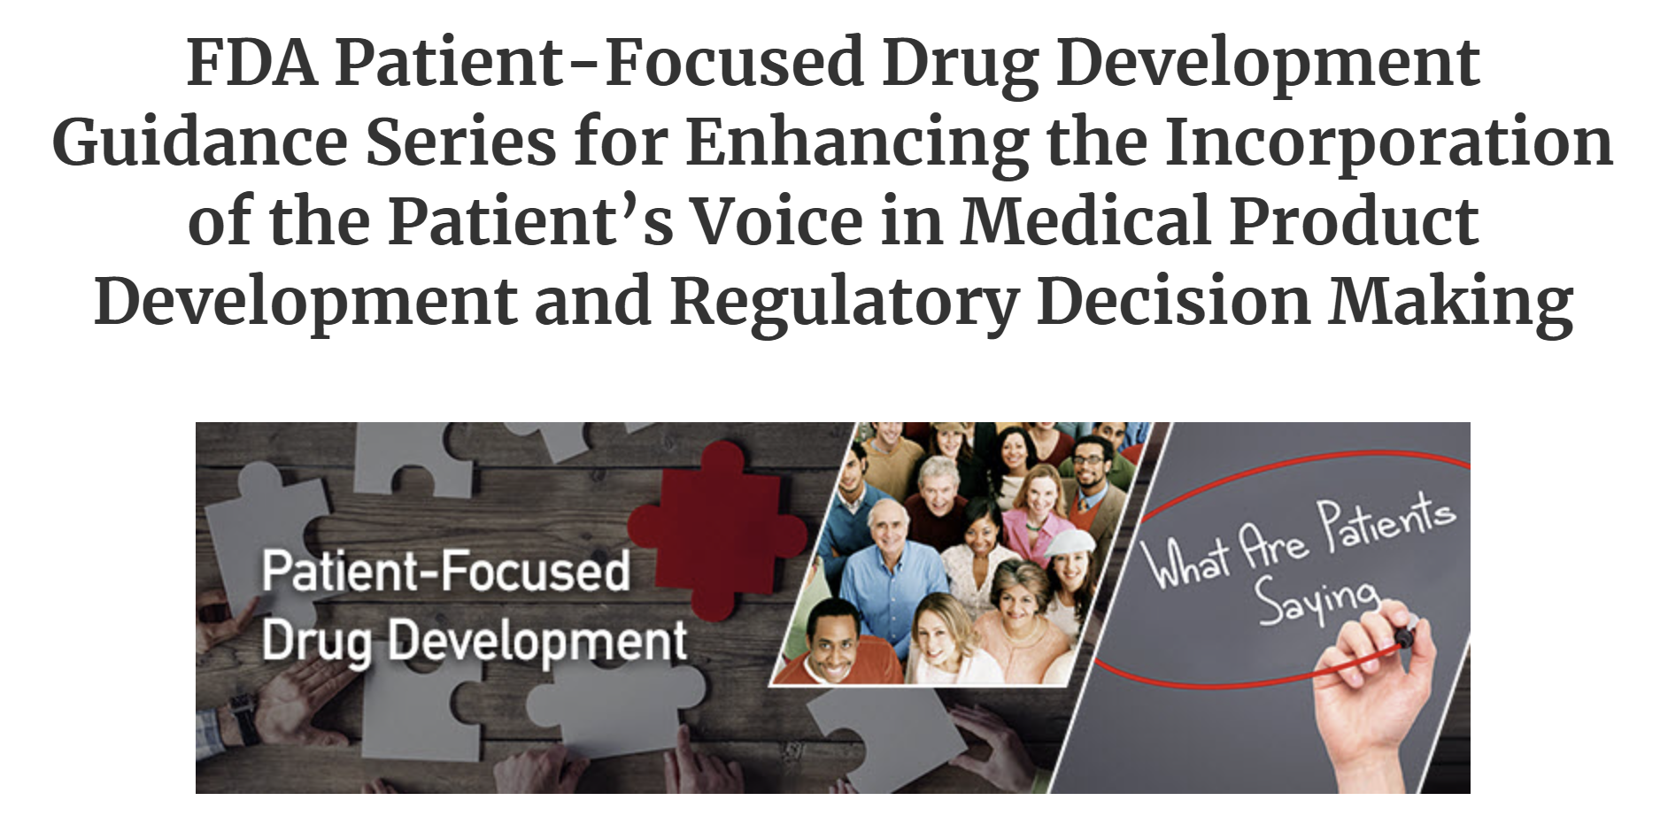
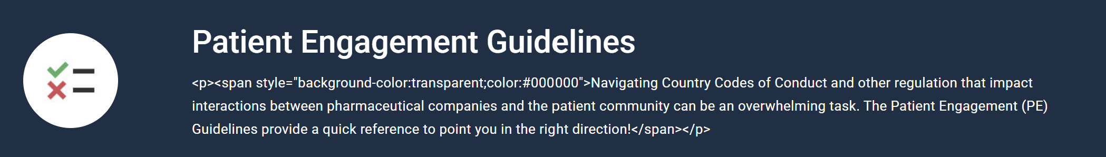
Regulators are calling for patient-focused drug development and guidance is available
Mandated by the 21st Century Cures Act, the FDA has developed a series of Patient-Focused Drug Development (PFDD) guidance documents to assist stakeholders in collecting and submitting patient experience data.
Reinforcing patient relevance in evidence generation is a key strategic priority for the EMA.
"Promoting the use of patient-reported outcomes and other tools for patient preference and engagement in regulatory decision-making."
EMA’s framework for interaction with patients
Patient engagement in scientific advice and committees
Informed compliance officers are your ally!
EMA, European Medicines Agency; EU, European Union; FDA, US Food and Drug Administration; PFDD, Patient-Focused Drug Development.

Slide 10






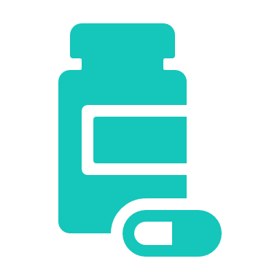



Successful medical affairs teams are recognising the value of patient engagement and embracing it!
The value of patient engagement in drug development is clear
Medical Affairs teams with the passion and vision to conceptualize ways to involve and engage patients throughout the development lifecycle will lead their organizations' success while making a real difference in human lives
Well-defined unmet needs ​
Enhanced disease awareness​
Relevant outcomes that matter​
Convenient, efficient, and representative trials​
Scientific evidence connected to real-world patient experiences and outcomes​
Quality medicines
Faster approvals
Trusted patient collaborations through meaningful engagement
Medical Affairs will ensure that patient insights are embedded in
all data generation strategies and activities, and that patients have
ready access to medical information that enables their active
participation in making treatment choices
Clinical and commercial success
The Future of Medical Affairs 2030, Medical Affairs Professional Society (MAPS) 2022. Accessed at https://medicalaffairs.org/future-medical-affairs-2030/.

Slide 11
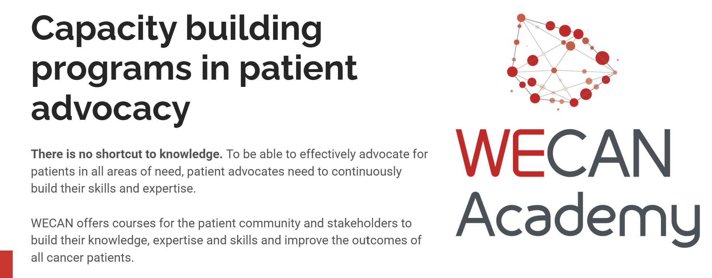
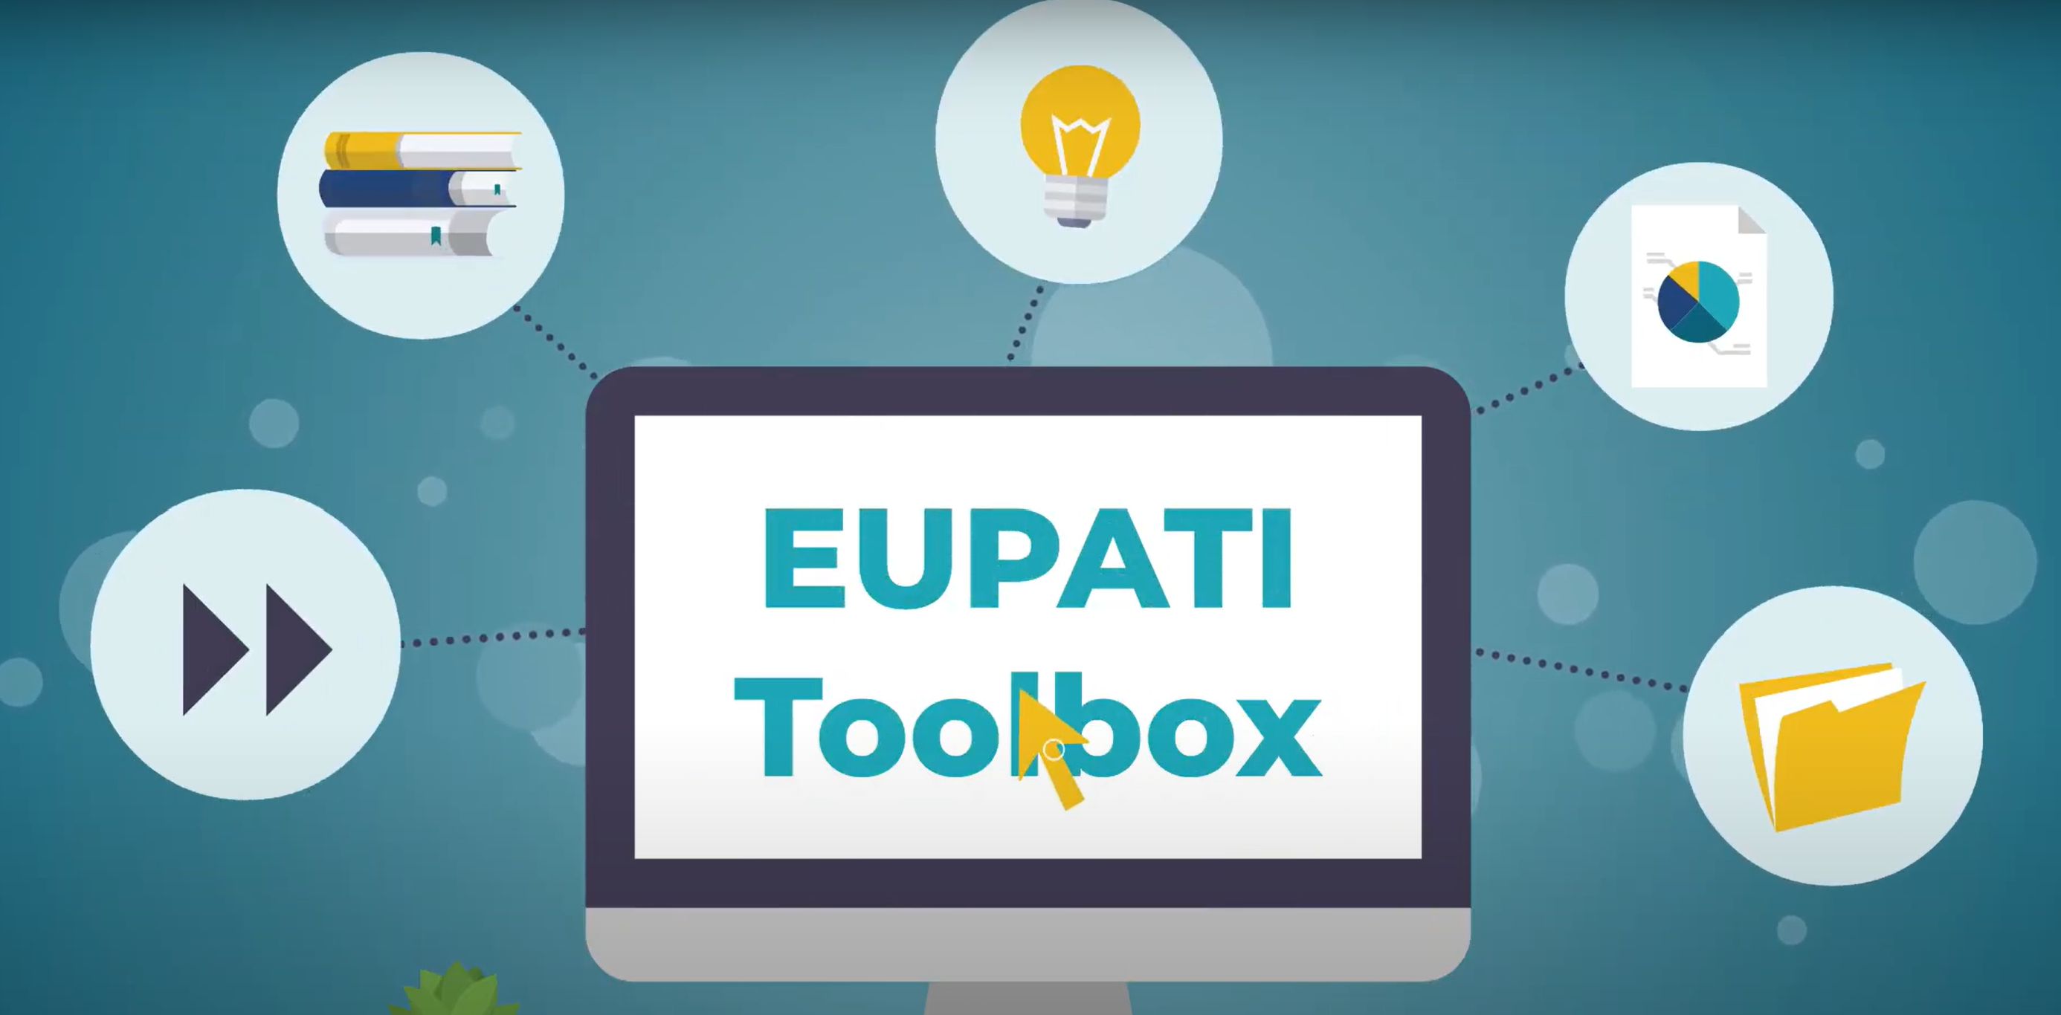


Patients are upskilling to ensure effective strategic partnerships
Nothing about us without us
Slogan adopted by patient organisations that emphasises the need for patient inclusion

Slide 12

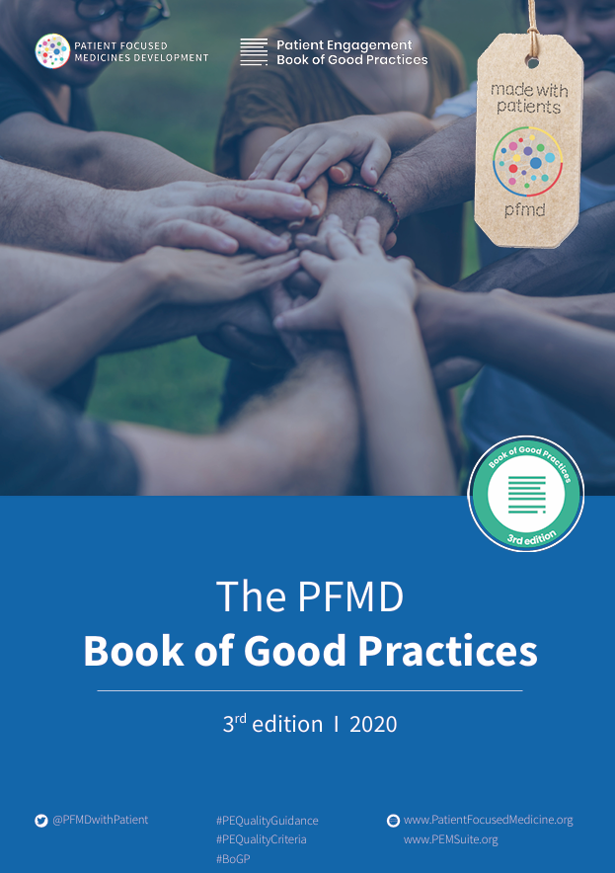

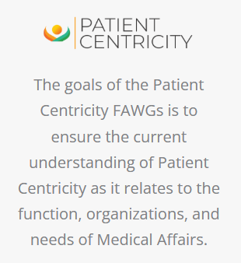

Lots of great examples and guidance – get inspired!!
Patient Engagement
PFMD, Patient Focused Medicines Development.

Slide 13
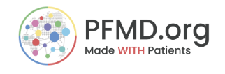
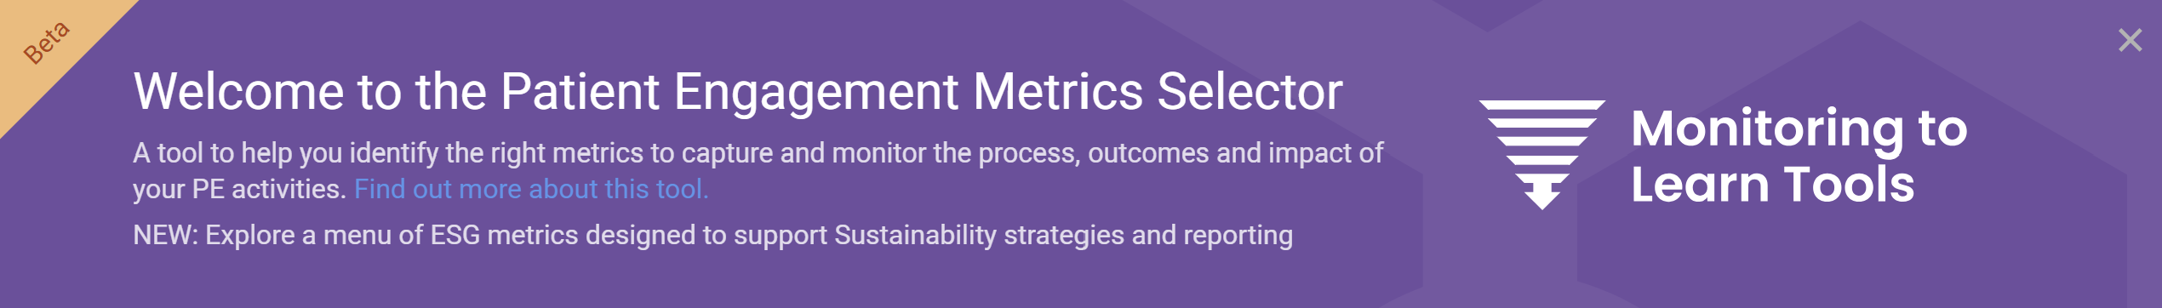
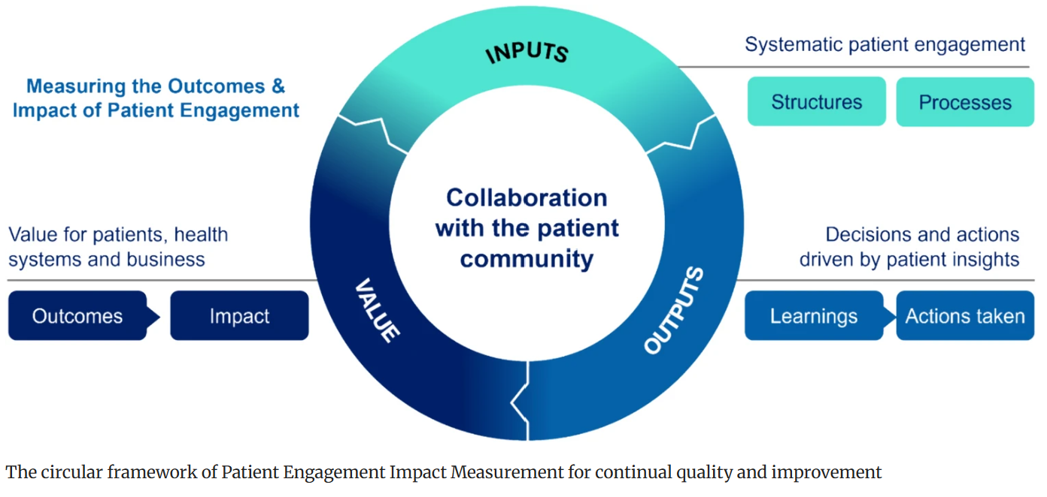

Be sure to demonstrate the value of your initiative…
Klein B, et al. The Patient – Patient-Centered Outcomes Research. 2025;18:3-18. https://doi.org/10.1007/s40271-024-00713-7.

Slide 14
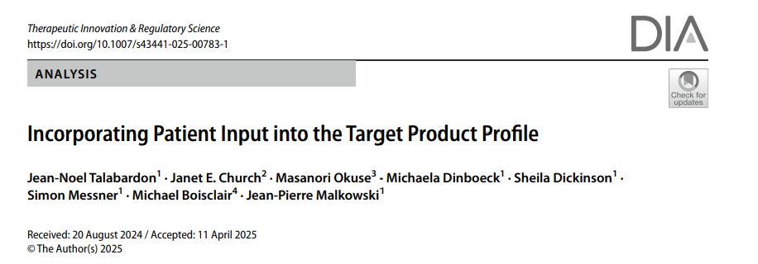
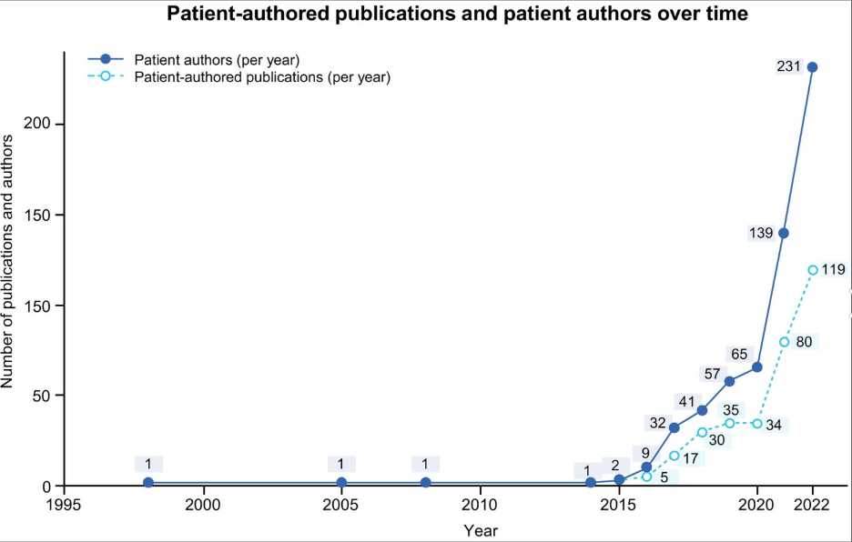
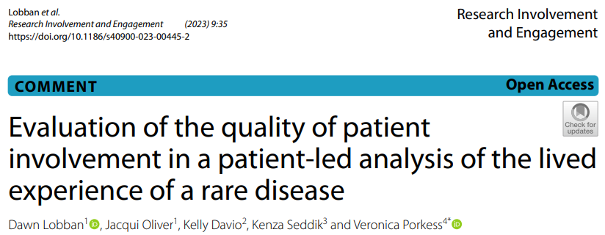
…And publish it (with patients) to build the evidence base!
Use the ‘patient author’ tag
Talabardon JN, et al. Ther Innov Regul Sci (2025). https://doi.org/10.1007/s43441-025-00783-1
Lobban et al. Research Involvement and Engagement (2023) 9:35 https://doi.org/10.1186/s40900-023-00445-2
Woolley, K.L. et al. Learned Publishing, 37: e1607. https://doi.org/10.1002/leap.1607

Slide 15
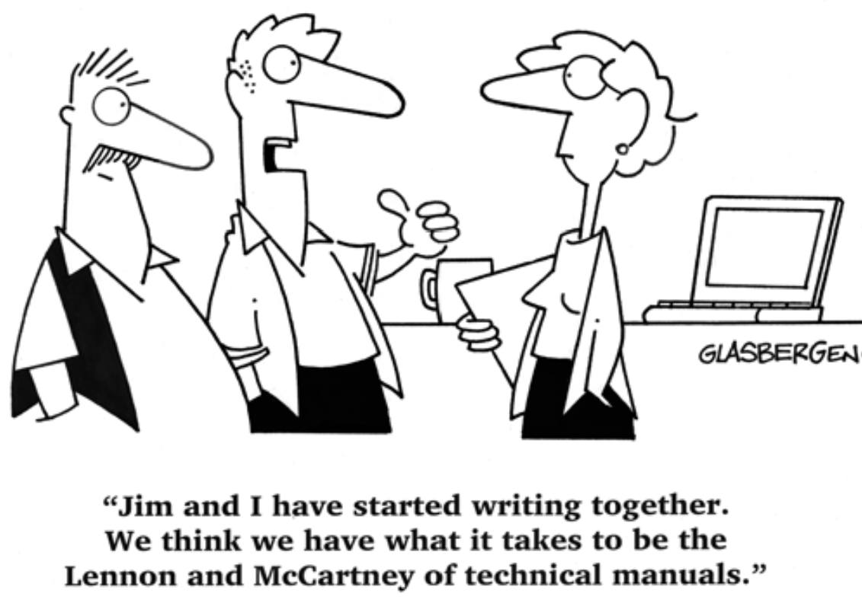
Trend: Shifting role - From technical experts to inspiring engagers

Slide 16
The evolving attributes of medical communicators
Therapy area knowledge
Scientific precision
Technical writing
Strategic interpretation
HCP stakeholder engagement
Facilitator / moderator
Cross-functional collaborator
Diverse perspectives
Cultural sensitivity
Authentic and inclusive language
Emotional intelligence
Effective Storytelling
Driving forces include:
Artificial intelligence
Patient engagement

Slide 17





What does this mean for agency recruitment and development?
Artificial intelligence expertise
Patient engagement expertise
Health literacy
training
Understanding
lived experience
Embracing
diversity
Celebrating
‘Soft’ skills

Slide 18
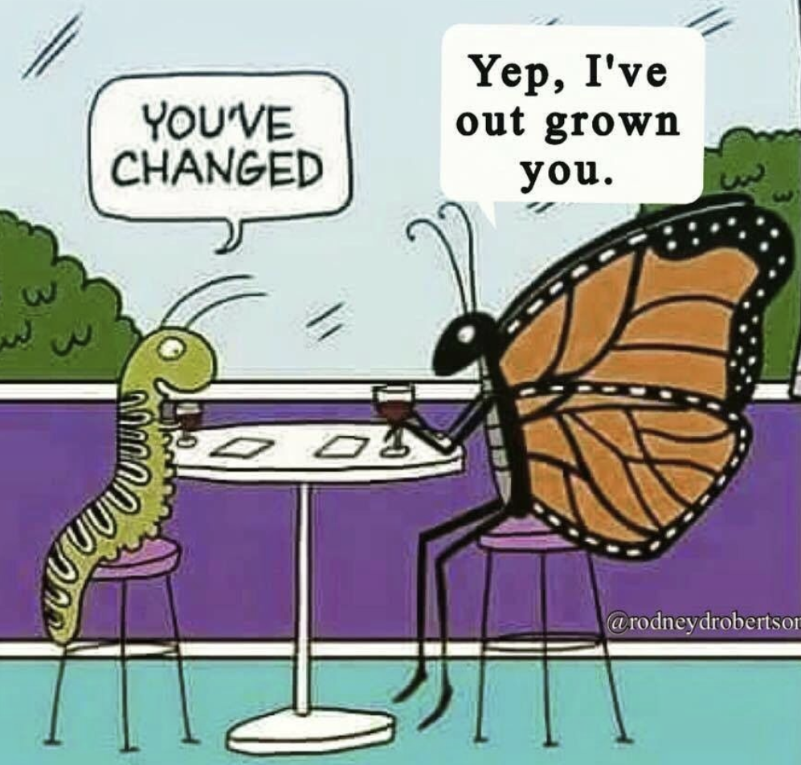
What does it mean for you?

Slide 19
How can you embrace these industry trends?
1
Find the agency / right role for you – inspired and encouraged
2
Embrace A.i. – but use it wisely and retain the fundamentals
3
Celebrate your ‘human’ skills and collaborate with different stakeholders
4
Collaborate with each other!
Alone we can do so little;
Together we can do so much.
Helen Keller

